Slide 1
Data Modeling
Sumber: Silberschatz, Korth and Sudarshan, Database System Concepts, 6th Ed.
Jeffrey A. Hoffer, Mary B. Prescott, Fred R. McFadden, Modern Database Management, 8th Ed.
Program Studi Teknik Informatika
Institut Teknologi Bandung

Slide 2
Learning Outcomes
Categorize data models based on the types of concepts that they provide to describe the database structure—that is, conceptual data model, logical data model, and physical data model

Slide 3
Data Modeling
Data modeling is a process used to define and analyze data requirements needed to support the business processes within the scope of corresponding information systems in organizations.
Involves professional data modelers working closely with business stakeholders, as well as potential users of the information system.
There are three different types of data models produced while progressing from requirements to the actual database.
Conceptual data model: a set of technology independent specifications about the data and is used to discuss initial requirements with the business stakeholders.
Logical data model: the structures of the data that can be implemented in databases.
Physical data model: that organizes the data into tables, and accounts for access, performance and storage details.
Notes:
Involves = melibatkan

Slide 4
Data Models
A collection of tools for describing
data
data relationships
data semantics
data constraints
Entity-Relationship model
Relational model
Other models:
object-oriented model
semi-structured data models
Older models: network & hierarchical model

Slide 5
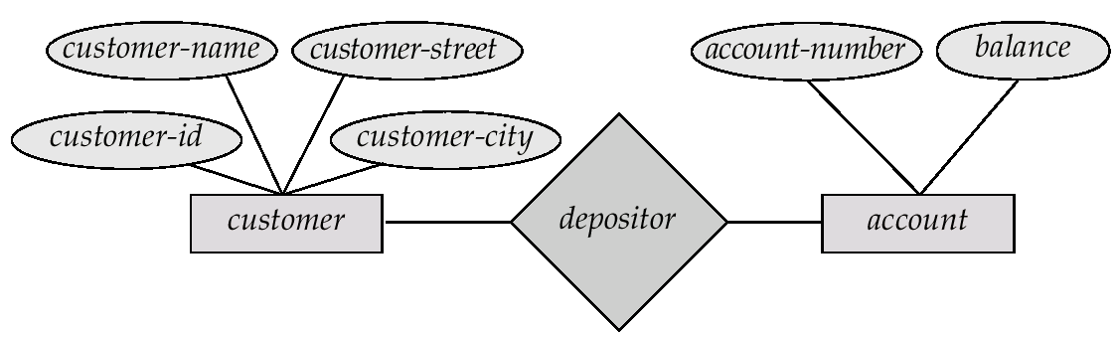
Entity-Relationship Model
Example of schema in the entity-relationship model

Slide 6
Entity Relationship Model (Cont.)
E-R model of real world
Entities (objects)
E.g. customers, accounts, bank branch
Relationships between entities
E.g. Account A-101 is held by customer Johnson
Relationship set depositor associates customers with accounts
Widely used for database design
Database design in E-R model usually converted to design in the relational model (coming up next) which is used for storage and processing

Slide 7
Relational Model
Example of tabular data in the relational model
Attributes
Customer-id
customer-
name
customer-
street
customer-
city
account-
number
192-83-7465
019-28-3746
192-83-7465
321-12-3123
019-28-3746
Johnson
Smith
Johnson
Jones
Smith
Alma
North
Alma
Main
North
Palo Alto
Rye
Palo Alto
Harrison
Rye
A-101
A-215
A-201
A-217
A-201

Slide 8
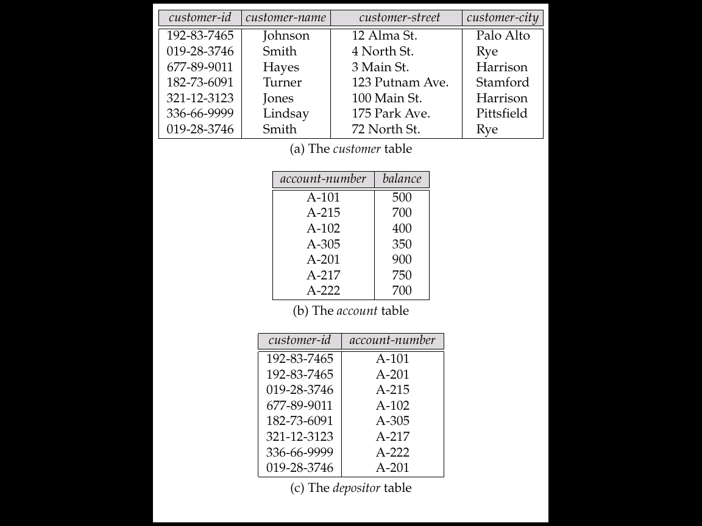
A Sample Relational Database

Slide 9
Object-Oriented Data Model
Loosely speaking, an object corresponds to an entity in the E-R model.
The object-oriented paradigm is based on encapsulating code and data related to an object into single unit.
The object-oriented data model is a logical data model (like the E-R model).
Adaptation of the object-oriented programming paradigm (e.g., Smalltalk, C++) to database systems.
Notes:
loosely speaking, an object corresponds to an entity in the e-r model. = secara bebas bisa diartikan: sebuah objek berhubungan dengan entitas dalam model e-r.

Slide 10
Object Structure
An object has associated with it:
A set of variables that contain the data for the object. The value of each variable is itself an object.
A set of messages to which the object responds; each message may have zero, one, or more parameters.
A set of methods, each of which is a body of code to implement a message; a method returns a value as the response to the message
The physical representation of data is visible only to the implementor of the object
Messages and responses provide the only external interface to an object.
The term message does not necessarily imply physical message passing. Messages can be implemented as procedure invocations.

Slide 11
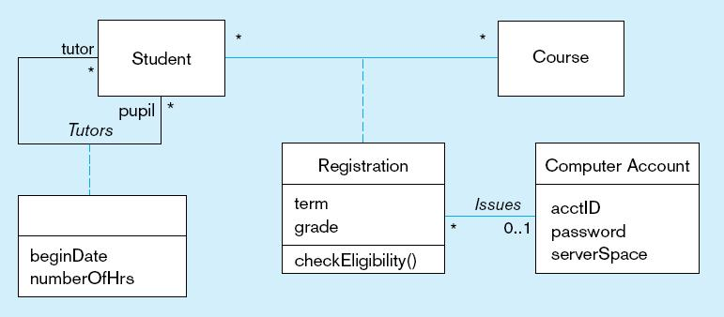
Figure 15-6a
Class diagram showing association classes
Registration class implements a many-to-many association between Student and Course

Slide 12
Object-Relational Data Models
Relational model: flat, “atomic” values
Object Relational Data Models
Extend the relational data model by including object orientation and constructs to deal with added data types.
Allow attributes of tuples to have complex types, including non-atomic values such as nested relations.
Preserve relational foundations, in particular the declarative access to data, while extending modeling power.
Provide upward compatibility with existing relational languages.
Notes:
12

Slide 13
Semi Structured Data Model
Paradigm shift caused by Web Technology:
from relational model to semi structured data
from data processing to data/query translation
from storage to transport
Origins:
Integration of heterogeneous sources
Data sources with non-rigid structure
Biological data
Web data

Slide 14
Semi Structured Data Model (cont.)
Characteristics:
organized in semantic entities
similar entities are grouped together
entities in same group may not have same attributes
order of attributes not necessarily important
not all attributes may be required
size of same attributes in a group may differ
type of same attributes in a group may differ
→Self-describing, irregular data, no a priori structure

Slide 15
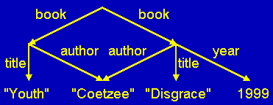
Semi Structured Data – Graph Representation
Complex Object
Atomic Object

Slide 16
XML: Extensible Markup Language
Defined by the WWW Consortium (W3C)
Originally intended as a document markup language not a database language
The ability to specify new tags, and to create nested tag structures made XML a great way to exchange data, not just documents
XML has become the basis for all new generation data interchange formats.
A wide variety of tools is available for parsing, browsing and querying XML documents/data
Notes:
16

Slide 17
Syntax for Semi Structured Data
Bib: &o1 { paper: &o12 { … },
book: &o24 { … },
paper: &o29
{ author: &o52 “Abiteboul”,
author: &o96 { firstname: &243 “Victor”,
lastname: &o206 “Vianu”},
title: &o93 “Regular path queries with constraints”,
references: &o12,
references: &o24,
pages: &o25 { first: &o64 122, last: &o92 133}
}
}
Observe: Nested tuples, set-values, oids (oids may be omitted)

Slide 18
Network Model
Data are represented by collections of records.
similar to an entity in the E-R model
Records and their fields are represented as record type
type customer = record type account = record customer-name: string; account-number: integer; customer-street: string; balance: integer; customer-city: string;
end end
Relationships among data are represented by links
similar to a restricted (binary) form of an E-R relationship
restrictions on links depend on whether the relationship is many-many, many-to-one, or one-to-one.

Slide 19
Network Model Data-Structure Diagrams
Schema representing the design of a network database.
A data-structure diagram consists of two basic components:
Boxes, which correspond to record types.
Lines, which correspond to links.
Specifies the overall logical structure of the database.

Slide 20
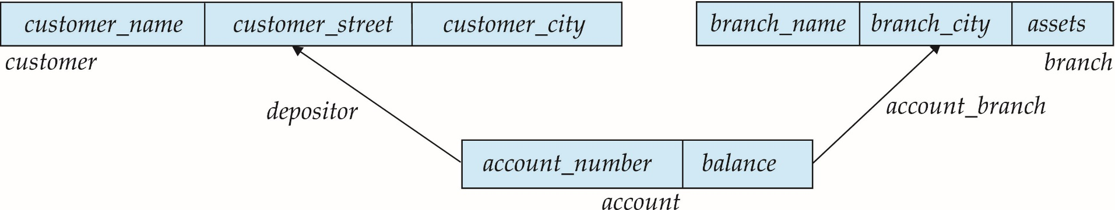
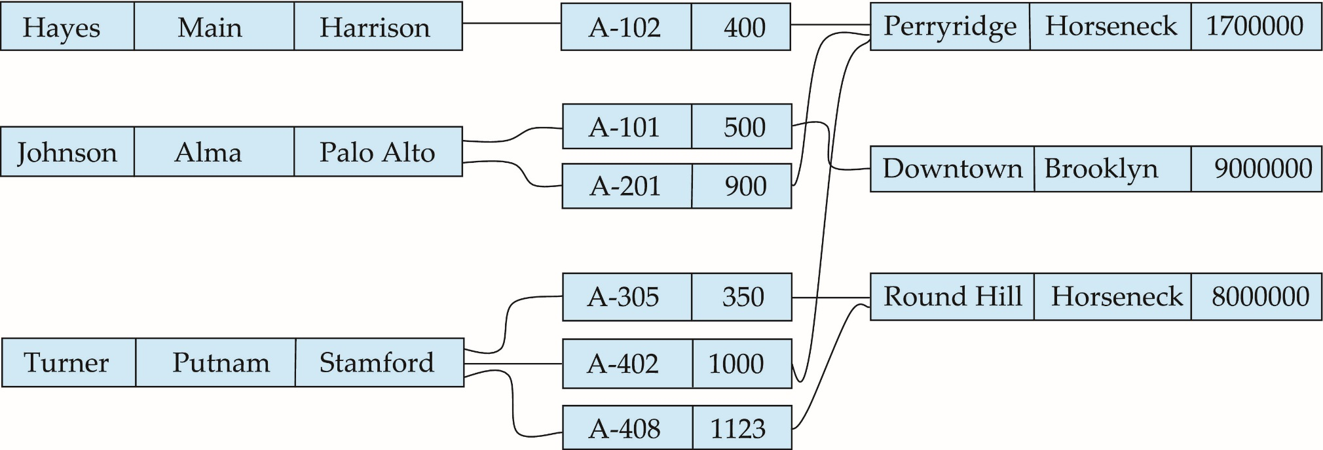
Example Schema

Slide 21
Hierarchical Model
A hierarchical database consists of a collection of records which are connected to one another through links.
a record is a collection of fields, each of which contains only one data value.
A link is an association between precisely two records.
The hierarchical model differs from the network model in that the records are organized as collections of trees rather than as arbitrary graphs.
Notes:
Precisely = tepat
Arbitrary = acak, semaunya

Slide 22
Hierarchical Model Tree-Structure Diagrams
The schema for a hierarchical database consists of
boxes, which correspond to record types
lines, which correspond to links
Record types are organized in the form of a rooted tree.
No cycles in the underlying graph.
Relationships formed in the graph must be such that only one-to-many or one-to-one relationships exist between a parent and a child.

Slide 23
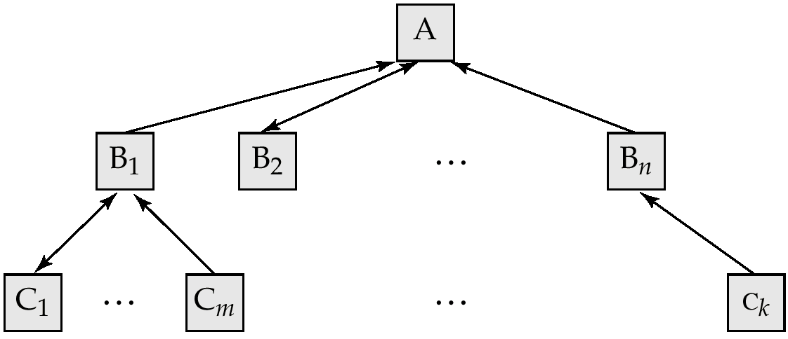
Hierarchical Model General Structure
A parent may have an arrow pointing to a child, but a child must have an arrow pointing to its parent.

Slide 24
Tree-Structure Diagrams (Cont.)
Database schema is represented as a collection of tree-structure diagrams.
single instance of a database tree
The root of this tree is a dummy node
The children of that node are actual instances of the appropriate record type
When transforming E-R diagrams to corresponding tree-structure diagrams, we must ensure that the resulting diagrams are in the form of rooted trees.

Slide 25
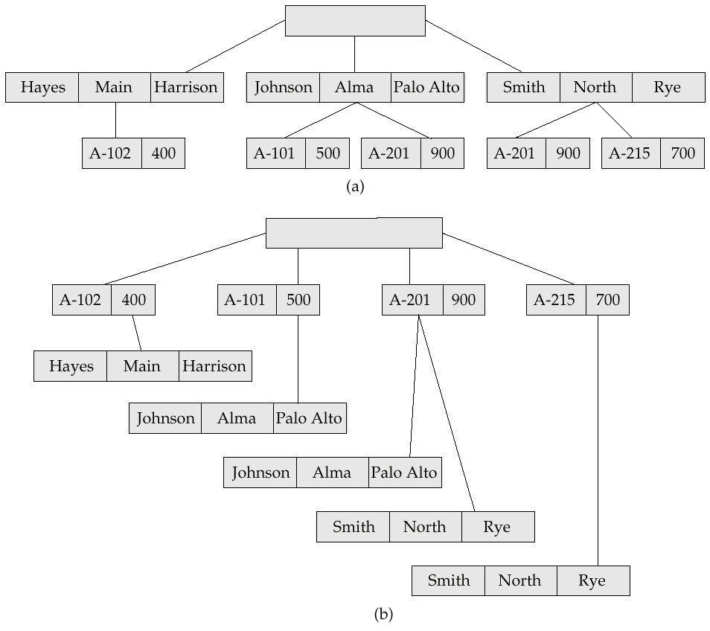
Sample Database

